Slide 1


JUnit 5
Testing Code with

Slide 2
What is a unit test ?
A unit test is a block of code that verifies the accuracy of a smaller, isolated block of application code, typically a function or method
block of code
Verifies
isolated

Slide 3
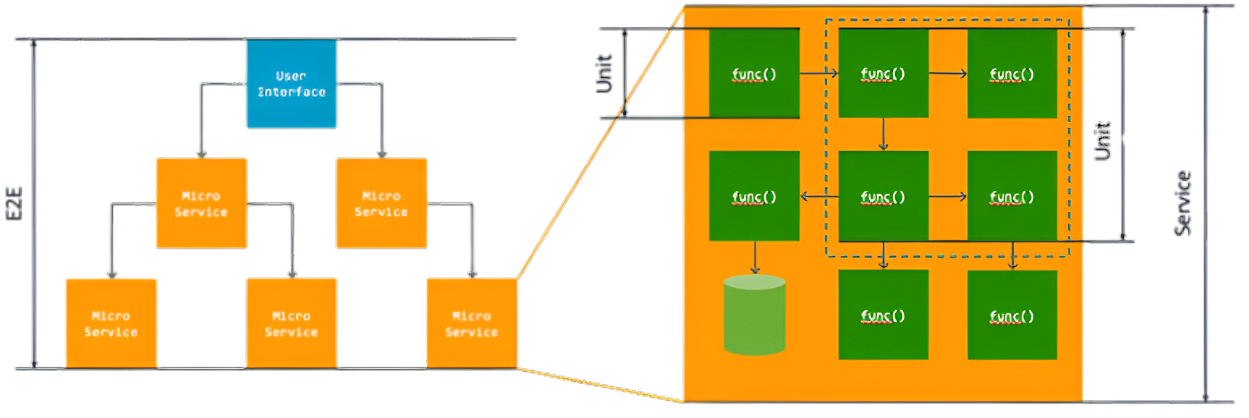
Representation
Image source:
AWS. (2024). What is Unit Testing? - Unit Testing Explained - AWS. Amazon Web Services, Inc. https://aws.amazon.com/what-is/unit-testing/
‌

Slide 4
Three Main Components
JUnit Platform
Base layer for launching tests on the JVM and allows any test engine (JUnit, KotlinTest, Spock, etc) to run on the same platform
JUnit Jupiter
New programming model + Annotations with clean, modern APIs and improved lifecycle methods
JUnit Vintage
Backward compatibility which lets you run JUnit 3 & 4 tests without rewriting

Slide 5
How do You Set up a Test ?
Install a JDK and Maven
Run Maven from the project root folder
Configure pom.xml with JUnit Jupiter and the Surefire plugin so Maven can discover and run tests
Put test files under src/test/java/... with a package that matches your main code

Slide 6
Let's get practical
Live demo:
Use a piece of code
Grab a function or method
Carry out a small test
Conclude

Slide 7
S U M M A R Y
Segmentable
surgical and effective
saves time and money
makes development more reliable

Slide 8
Programming is fun and Jesus is Lord

